Slide 1


AM802002 Research and Enquiry
Week 1 (Session 1): Introduction to Scientific Research within the Applied Management Context

Slide 2
In this lecture:
What should you know about this course?
What is business research?
What is the scientific method?
How a research topic is developed?
How would you plan out Assignment One?

Slide 3

Introduction
Lecturer: Dr Varun Bhardwaj
Email: varun.Bhardwaj@futureskills.co.nz
Learning assistant: Research Methods Support (RMS) Chatbot (Teams)
Let’s get to know each other!
Share where you are from.
An interest/hobby or two that you have.
Share a management-related area/topic that you are interested in.

Slide 4
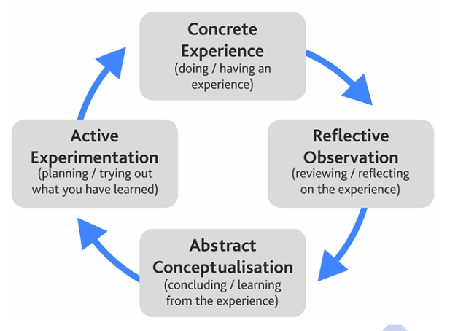
Teaching Approach
Experiential learning approach

Slide 5
Checklist before we start
1. Class times (Weeks 1-8): Thanks so much for coming to class on time, well done!
2. Attendance (write your name and arrival time on the Excel sheet for attendance records)
Everyone should be in class on time including the lecturer.
5 to 15 minutes after the start of class the student will be marked late.
After 15 minutes, students will be marked absent.
Please contact Student Success and show medical evidence for absence.
If a student leaves before the class finishes, then they will be marked absent. Immigration says they must be present for all classes and OPAIC are required to report ongoing absences.

Slide 6
Checklist before we start
3. Moodle (e.g., course outline, announcements, assignments and materials)
4. Student email (xxx@futureskills.co.nz)
5. Student Hub and Demonstration
6. Microsoft Teams and RMS Chatbot (Teams group: “Research and Enquiry 24-AIC-04 – Cohort 1 or 2”)
7. Student Support Services
Student Success (Level 1) (Non-academic support: e.g., wellbeing, career services)
Learning Support (Level 8) (Academic support: e.g., academic writing, referencing, peer-tutors)
8. Other Important Tools (e.g., Office 365, Roberston Library, Zotero; Grammarly)
Any questions?

Slide 7
Aim and Learning Outcomes
Aim:
To provide students with the skills needed to undertake an ethical organisational research enquiry.
Learning Outcomes (LOs):
On successful completion of this course students will be able to:
Conduct a critical literature review of a subject/area within an applied business management context (LO1).
Critically evaluate information to formulate justified research questions (LO2).
Critically assess research within an applied business management context (LO3).
Assignment One (30%)
Covers LO1
Due: Monday Week 4 (28 October 2024), 9:00 AM
Assignment Two (70%)
Covers LOs 1-3
Due: Monday Week 9 (2 September 2024), 9:00 AM

Slide 8

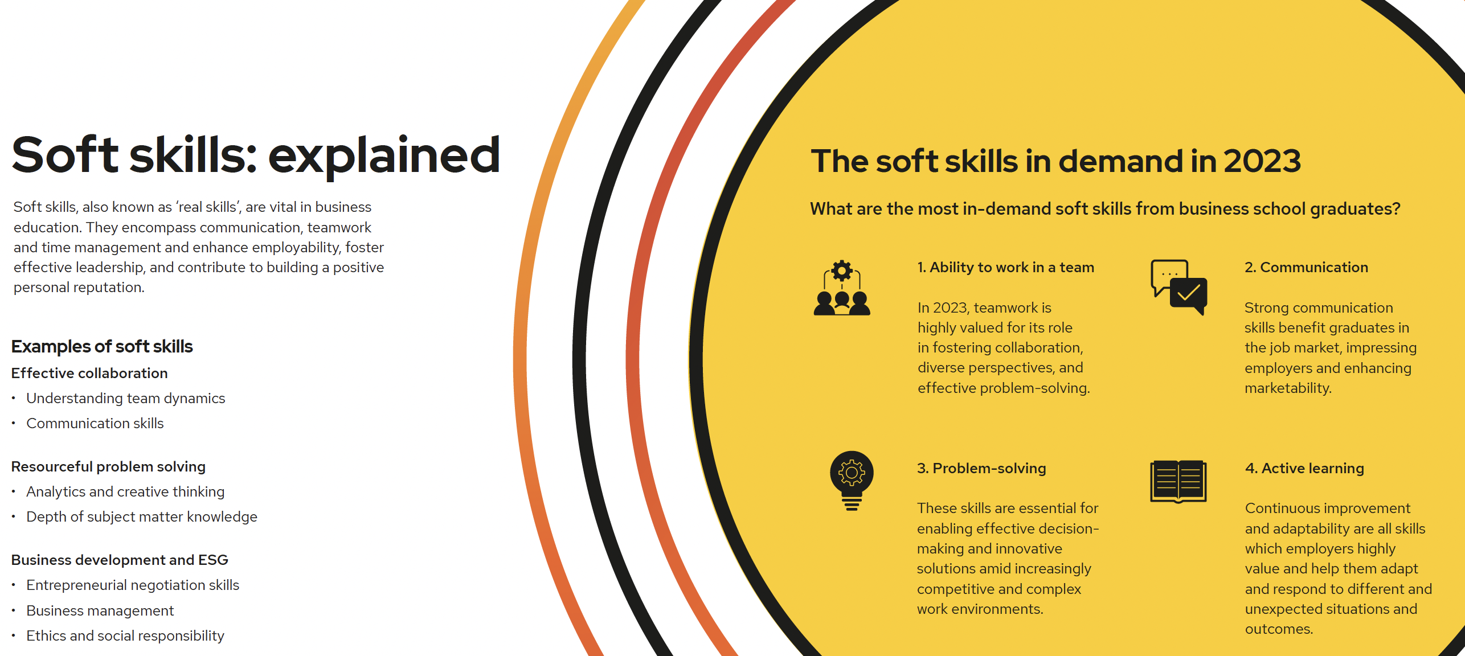
Skills Gap in Business Education

Slide 9
Activity One (Individual)
1. Class discussion around Skills Gaps:
Listen to the Skills Gaps Podcast
Take some notes
2. Please write something from your notes on the whiteboard.

Slide 10
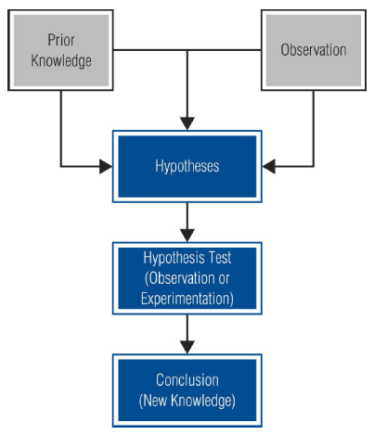
What is the scientific method?
Scientific methods in the area of Applied Management:
The way research go about using knowledge and evidence to reach objective conclusions about the real world.
The analysis and interpretation of empirical evidence (facts from observation or experimentation) to confirm or disprove prior conceptions.
Common research methods include:
Qualitative research methods
Quantitative research methods
Mixed-research methods
(Will be covered from Week 4)
What are the advantages of doing business research?
Source: Zikmund et al. (2013), p. 6

Slide 11
Assessment 1: Critical Review (30% to final grade)
Word count guidance: 1400 words (+/- 10%)
Due date: Monday Week 4 (28 October 2024), 9:00 AM
Assessment overview: This is the first of two assessments for this course. The objective of this assessment is to provide the students with knowledge of how to critically review and evaluate a published article regarding an empirical study from a peer-reviewed journal.
Conditions of assessment: This is an individual assessment that you will complete in your learner-managed time, however, your lecturer will provide opportunities during class time for clarification and guidance. All work must be completely your own and all literature used must be referenced appropriately using APA 7th edition. In order to pass this course, you must achieve a cumulative grade of at least 50%, across assessment one and two.
Learning outcome(s) assessed: Conduct a critical literature review of a subject/area within an applied business management context.

Slide 12
Assessment 1: Critical Review
Instructions:
To prepare for this assessment you will:
Using secondary research, identify an area/topic of applied management that is of interest to you.
Identify keywords and undertake a keyword search of the literature using academic databases. All selected articles should have been published within the last five years.
Select a primary article that is highly relevant to the identified applied management area/topic, then select at least three articles on the research area/topic related to the primary article.
Write a critical literature review on the research area/topic of interest using the selected articles.
Your Critical Review will include:
An introduction to the review including how the primary and at least three supportive articles are located, evaluated, managed and used to support the identification of the applied management area/topic.
The body of the review itself, including explanation, evaluation, comparison and/or critique of relevant applied management concepts, ideas and opinions from the selected articles, implications for applied management practice.
Conclusions drawn from your analysis of the articles.
A full Reference list using the correct APA referencing style.

Slide 13
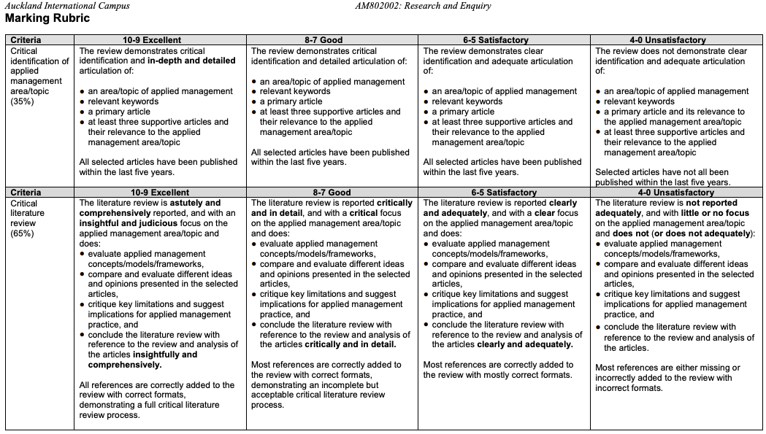
Assessment 1: Marking Rubric

Slide 14
How to plan out your assessment?
To prepare for this assessment, you will:
Identify a research topic and question in the area of Applied Management (please confirm the topic and question with me)
Identify keywords and undertake a keyword search of the literature using identified academic databases (see Roberston Library)
Collect and read appropriate literature (1 primary plus minimum 3 supportive).
Organise and analyse the information in the literature
Write up your literature review
Your Literature Review will include:
An introduction to your research problem or statement. What is it and why is it important?
Body of your report with the use of subheading as appropriate.
Conclusions drawn from your analysis of the literature, including recommendation for future research.
Full Reference list using correct APA referencing style (use the reference management tool Zotero).

Slide 15
What is management research?
Management research is the application of the Scientific Method in searching for the truth about management phenomena.
The way research go about using knowledge and evidence to reach objective conclusions about the real world.
The analysis and interpretation of empirical evidence (facts from observation or experimentation) to confirm or disprove prior conceptions.

Slide 16
What are variables?
In research, variables are concrete and measurable indicators that represent change from one instance to another; can exhibit differences in values (usually in magnitude or strength) or in direction.
Dependent variable: A process outcome or a variable that is predicted and/or explained by other variables.
Independent variable: A variable that is expected to influence the dependent variable in some way.
A constant on the other hand is something that does not change; is not useful in addressing research questions.
Types of variables:
Continuous Variable: A variable that can take on a range of values that correspond to some quantitative amount (e.g., income, age, customer satisfaction score).
Categorical Variable: A variable that indicates membership in some groups (e.g., geographic region, industry, product type).

Slide 17
What are constructs?
In research, constructs are abstract concepts or ideas that researchers use to describe, understand, and measure real-world phenomena. Constructs are often measured using multiple variables or indicators.
Latent Constructs: Cannot be directly observed (e.g., intelligence, motivation)
Observable Constructs: Can be directly measured (e.g., height, weight)
Researchers must define how constructs will be measured or observed in a study through a process called operationalisation.
Types of constructs:
Theoretical Constructs: Abstract ideas developed to explain, predict, and understand phenomena (e.g., self-efficacy, organisational culture).
Empirical Constructs: Derived from observations and can be directly measured (e.g., job performance, customer satisfaction).

Slide 18
Variables versus constructs!
 | Variables | Constructs
Nature | Specific, measurable characteristics or attributes. | Abstract concepts or ideas.
Measurement | Can be directly observed or measured. | Cannot always be directly observed.
Complexity | Represent differences in values or categories. Generally simpler, singular attributes. | Represent real-world phenomena. More complex, multifaceted concepts.
Role in Research | Used to operationalise and measure constructs. | Form the theoretical foundation of research.
Examples | Employee age, salary level, gender distribution in leadership roles, performance evaluation scores | Emotional intelligence, employee motivation, organisational culture, leadership effectiveness

Slide 19
Variables versus constructs!
Construct | Variables
Job Satisfaction | Salary rating, work-life balance score, promotion opportunities
Employee Motivation | Productivity metrics, attendance rate, voluntary overtime hours, participation in optional training programs
Customer Loyalty | Repeat purchase frequency, length of customer relationship, referral rate, positive review scores
Leadership Effectiveness | Employee satisfaction scores, team performance metrics, goal achievement rates, 360-degree feedback ratings
Job Performance | Task completion rate, quality of work assessments, customer satisfaction scores, achievement of KPIs
Change Readiness | Adaptation speed to new processes, resistance levels to change initiatives, participation in change-related training, employee feedback on change communications

Slide 20
From situations to variables
Situation | Symptoms | Problem(s) | Decision Statement
Conduct situation analysis including interviews with key decision makers |  | Consider results of probing and apply creative processes | Express in actionable terms and make sure decision makers are in agreement
22-year-old neighbourhood swimming association seeks research help | Declining membership for 6 years Increased attendance at new water park Less frequent usage among members | Swim facility is outdated and does not appeal to younger families. Younger families and children have a negative image of pool. Their ‘old market’ is aging | What things can be done to energise new markets and create a more favourable attitude toward the associate?
A new microbrewery is trying to establish itself | Consumers seem to prefer national brands over the local microbrew products Many customers order national brands within the microbrew itself Some customers hesitant to try new microbrew flavours | Is there a negative flavour gap? Do consumers appreciate the microbrew approach and the full beer tasting (as opposed to drinking) experience? | How can we encourage more consumers to come to the microbrew and try our products? Should we redesign the brewery to be more inviting?

Slide 21
From situations to variables
Decision Statement | Research Objectives | Research Questions | Research Hypotheses
Express in actionable terms and make sure decision makers are in agreement | Expresses potential research results that should aid decision-making | Ask a question that corresponds to each research objective | Specific statement explain relationship, usually involving two variables, and including the direction of the relationship
What things can be done to energise new markets and create a more favourable attitude toward the associate? | Determine reasons why families may choose to join or not join a ‘swim club’. | How do the types of facilities and pricing relation to family attitudes toward a swim facility? | Child-friendly pool design are positivity related to attitudes towards the facility. Flexible pricing policies are positively related to attitudes towards the facility.
How can we encourage more consumers to come to the microbrew and try our products? Should we redesign the brewery to be more inviting? | Describe how situational factors influence beer consumption and consumer attitudes toward beer products List factors that will improve attitudes toward the microbrewery. | Do situational factors (such as time of day, food pairing, or environmental factors) relate to taste perceptions of beers? | Microbrew beer is preferred when consumed with food. An exciting atmosphere will improve consumer attitudes toward the microbrew.

Slide 22
From situations to variables
Research Questions | Research Hypotheses | Constructs | Variables
Ask a question that corresponds to each research objective | Specific statement explain relationship, usually involving two variables, and including the direction of the relationship | Abstract concepts or ideas that explain real-world phenomena | Concrete and measurable indicators that represent change from one instance to another
How do the types of facilities and pricing relation to family attitudes toward a swim facility? | Child-friendly pool design are positivity related to attitudes towards the facility. Flexible pricing policies are positively related to attitudes towards the facility. | Family attitudes toward swim facilities (theoretical or latent) | Child-friendliness of facilities (more/less; continuous), flexibility of pricing policies (more/less; continuous)
Do situational factors (such as time of day, food pairing, or environmental factors) relate to taste perceptions of beers? | Microbrew beer is preferred when consumed with food. An exciting atmosphere will improve consumer attitudes toward the microbrew. | Beer preference (theoretical or latent) | Presence of food, (with/without; categorical or discrete), type of beer (microbrew vs. others; categorical or discrete)

Slide 23
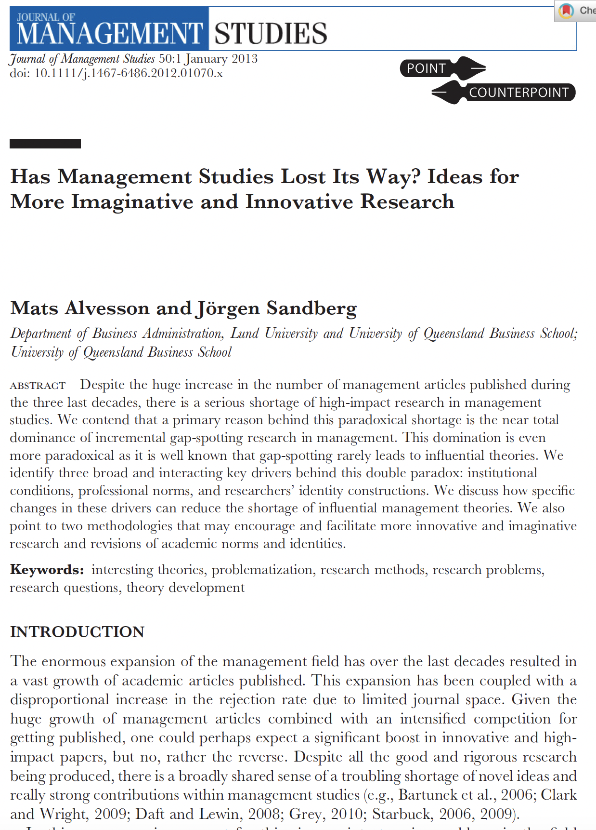
Has management research lost its way?
Alvesson, M., & Sandberg, J. (2013). Has management studies lost its way? Ideas for more imaginative and innovative research. Journal of management studies, 50(1), 128-152.

Slide 24
Activity Two (Group)
1. Group discussion around Management Research:
Sitting with your group, listen to the Management Research Podcast
Take some notes as an individual
2. Working as a team, get one sentence from each team member and write a summary of the podcast in four to five sentences.
3. Write the summary on the whiteboard working as a team. Each team member writes his/her sentence in the sequence in which they appear in the final summary.

Slide 25
Self-study
1. Write in Student Notebook as an individual:
Write three sentences describing what you learned today about management research in the Week One Section.
Write three sentences describing what you learned today about your first assignment in the Assignment One Section.
2. Interact with RMS Chatbot and Write Summary in Student Notebook
Have a conversation with the RMS Chatbot. Either talk about your first assignment or management research.
Write a five-sentence summary of the conversation.
If you talked about the first assignment, add the summary in the Assignment One Section. If you talked about management research, add the summary in the Week One Section.

